Slide 1

Audit / Assessment Dashboard
Presented By : Samar Jberi

Slide 2
General introduction

Slide 3
Table of Contents
01
02
03
04
Project presentation
Problematic
Solution
Adopted Methodology

Slide 4
Table of Contents
05
06
Used tools
Conclusion

Slide 5
01
Project Presentation

Slide 6
Presentation of the host organization

Slide 7

65 sites in over 20 countries

Slide 8
02
Problematic

Slide 9
03
Solution

Slide 10
04
Adopted Methodology

Slide 11
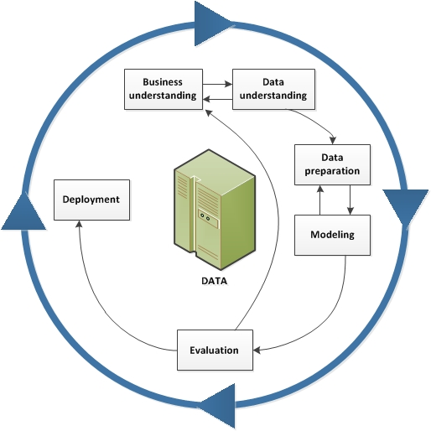
CRISP-DM

Slide 12
05
Used tools

Slide 13


Slide 14


Slide 15
06
Conclusion

